Slide 1

BUSINESS ADMINISTRATION
SOFTWARE
ALA-TOO INTERNATIONAL UNIVERSITY
Spring Semester 2025-2026

Slide 2
***
Simplicity is prerequisite for reliability.
— Edsger W. Dijkstra

Slide 3

1C: Enterprise 1C SYSTEM

Slide 4


DESIGNER MODE OUR PART
Selecting and implementing algorithms
Creating application’s structure
Setting up parameters
Morfing sets of predefined elements
Creating apps + updating and customizing exiting

Slide 5

ENTERPRISE MODE USER PART
Users input their own data to the applications using algorithms, parameters and settings implemented by developers. Users collaborate with each other and create reports.

Slide 6
DOWNLOAD AND INSTALL STEP 0
https://1c-dn.com/
Create an account, make sure you avoid all unnecessary ticks
Login to your account
Select “Free trial” at the top left
Choose your platform version and start the download
For the installation process just follow the installation wizard

Slide 7
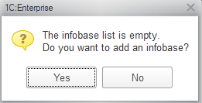
CREATING FIRST INFOBASE STEP 1
(SELECT NO OPTION)
Each infobase contains user’s data and program itself which the platform executes, therefor creation of any 1C:Enterprise application starts from creating an infobase where the application and the data driven by it will be stored.

Slide 8
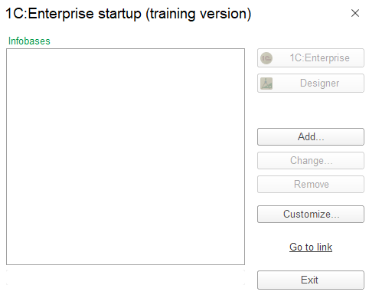
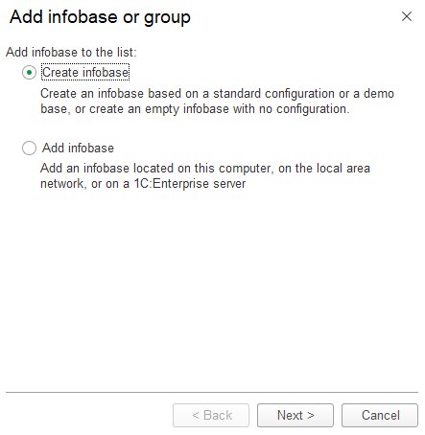
CREATING FIRST INFOBASE STEP 2
Select Add button
Select Create infobase

Slide 9
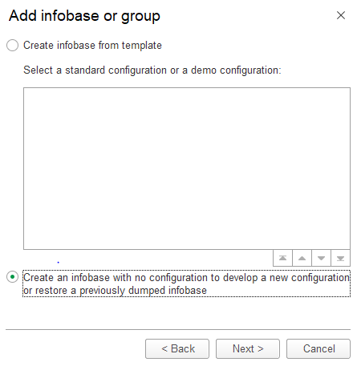
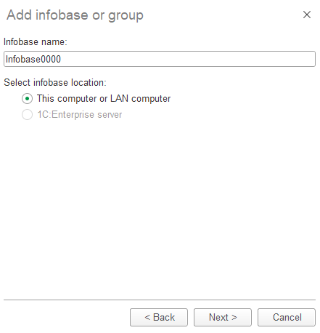
CREATING FIRST INFOBASE STEP 3
Select NEW infobase
Name it and keep on this pc

Slide 10
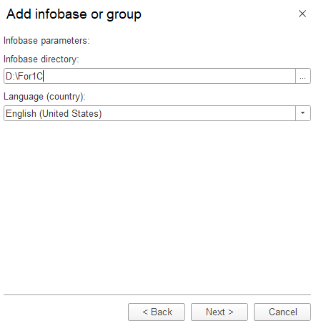
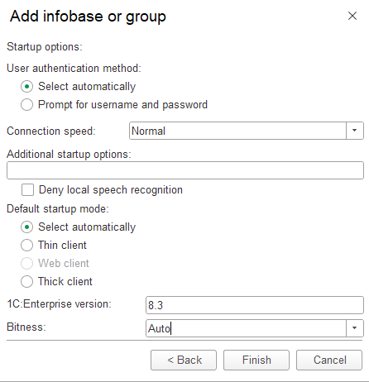
CREATING FIRST INFOBASE STEP 4
Select NEW infobase
Just select Finish

Slide 11
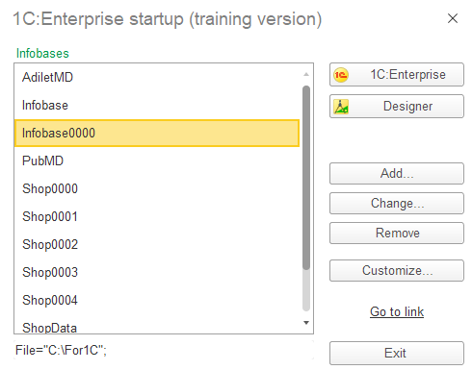
CREATING FIRST INFOBASE STEP 5
Select your infobase and press Designer

Slide 12
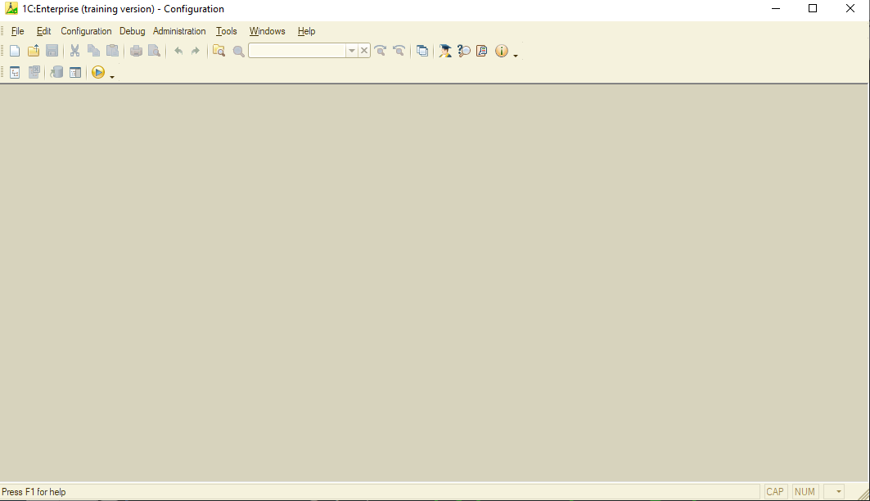
CONFIGURATIONS STEP 0
Select Configuration option on the top left corner then Open configuration

Slide 13
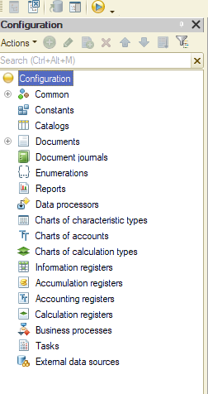
CONFIGURATIONS STEP 1
Make sure you get the configuration window with config tree

Slide 14
METADATA CLASSES AND OBJECTS
Metadata classes are basically business components, they are predefined and visually configurable building blocks that are widely used in enterprise applications:
Documents
Catalogs
Information registers
Accumulation registers
Accounting registers
Calculation registers
Business processes

Slide 15
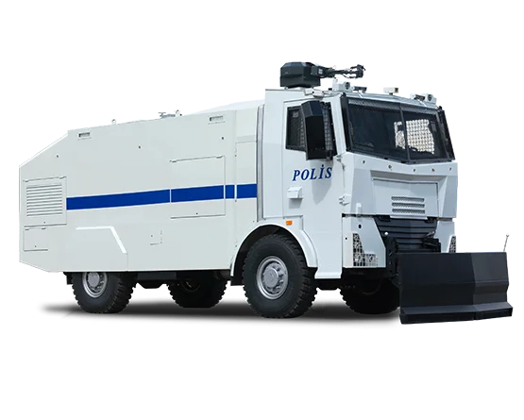


ANALOGY METADATA

Slide 16
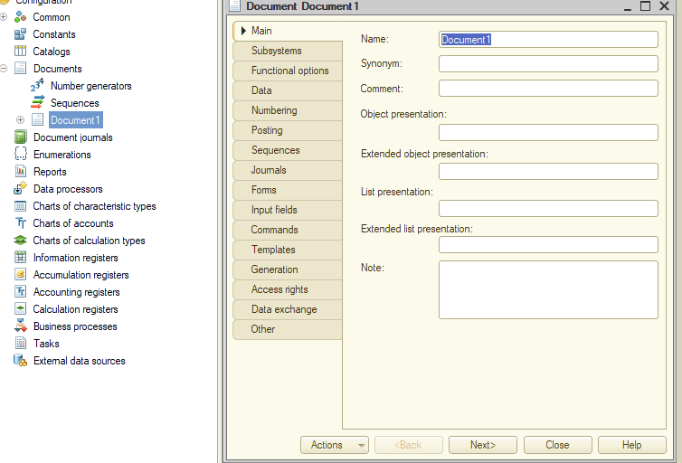
METADATA CLASS DOCUMENTS

Slide 17
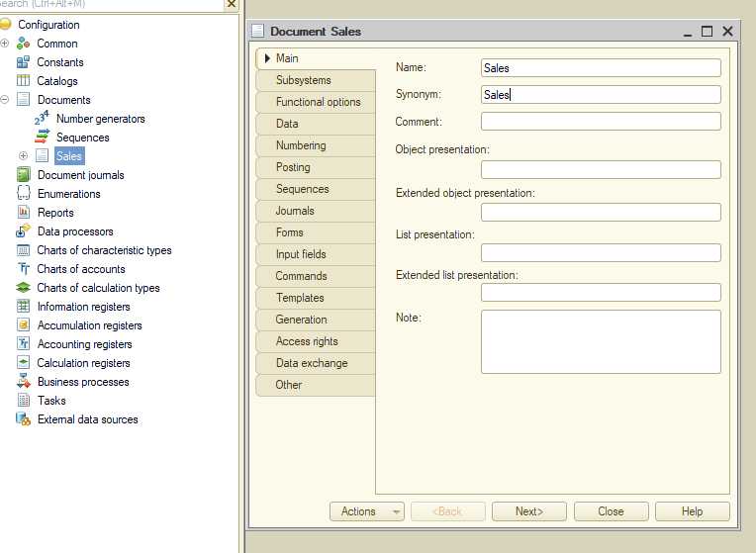
METADATA CLASS DOCUMENTS

Slide 18
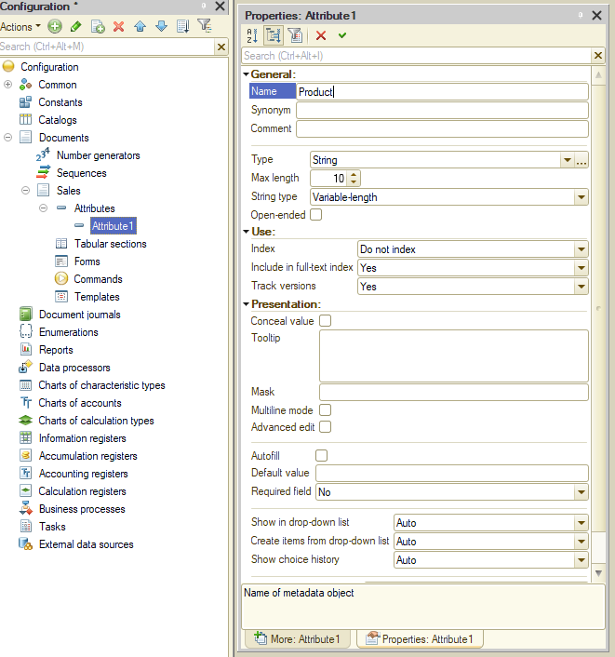
METADATA CLASS ATTRIBUTES

Slide 19
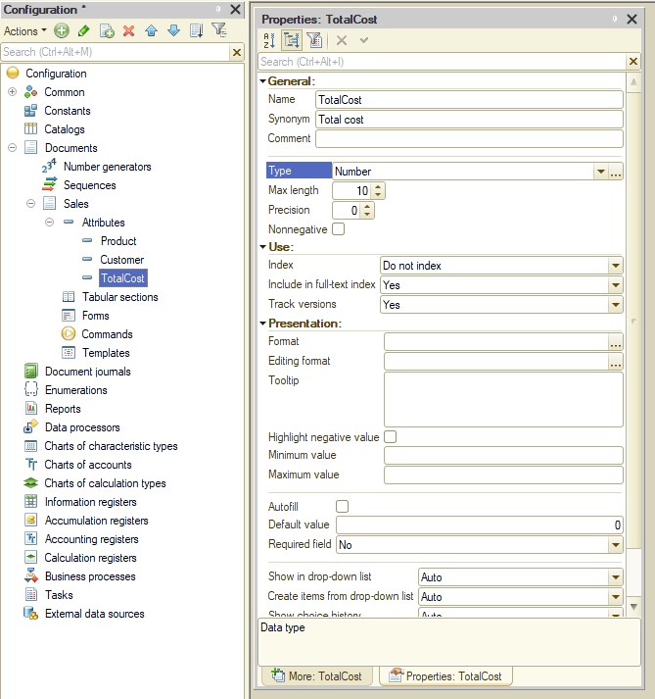
METADATA CLASS ATTRIBUTES

Slide 20
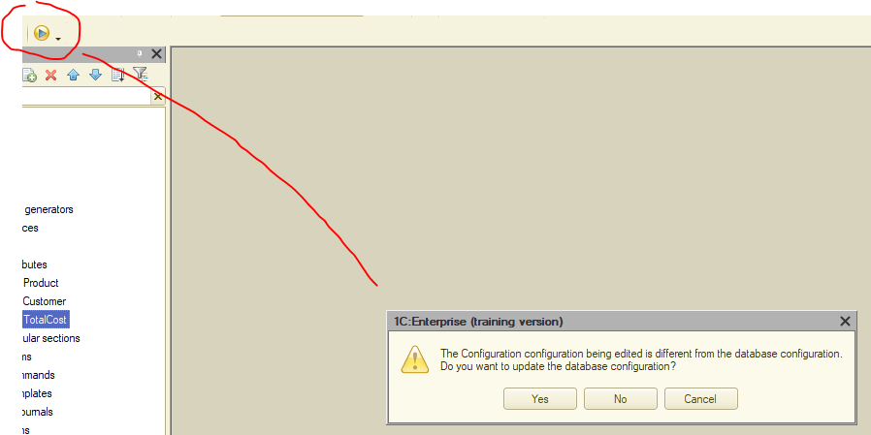
RESTRUCTURE DATA TO OPEN ENTERPRISE MODE

Slide 21
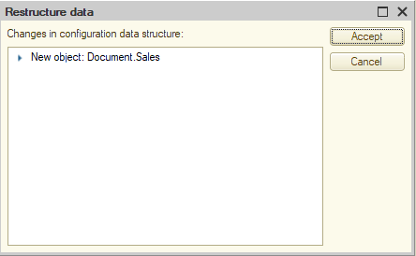
ENTERPRISE MODE ENTERPRISE MODE

Slide 22
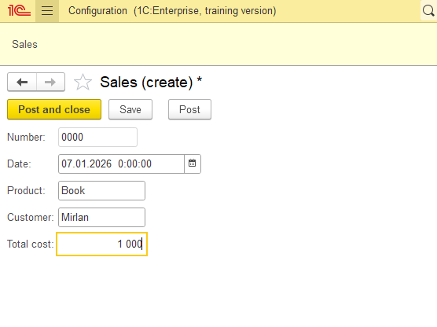
CONFIGURATIONS ENTERPRISE MODE

Slide 23
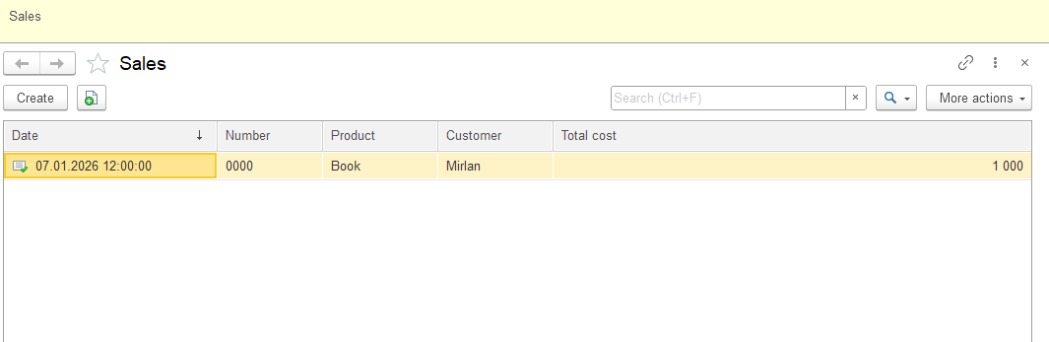
CONFIGURATIONS ENTERPRISE MODE

Slide 24
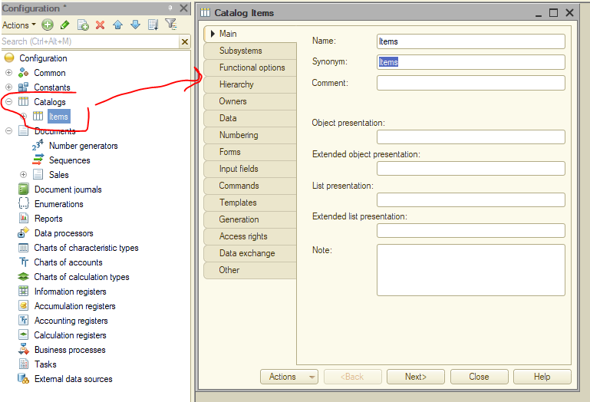
CATALOGS CREATION

Slide 25
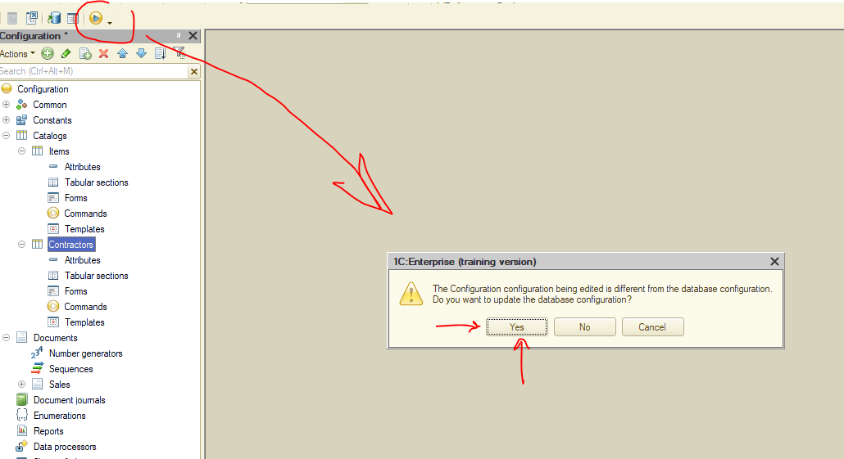
CATALOGS CREATION

Slide 26
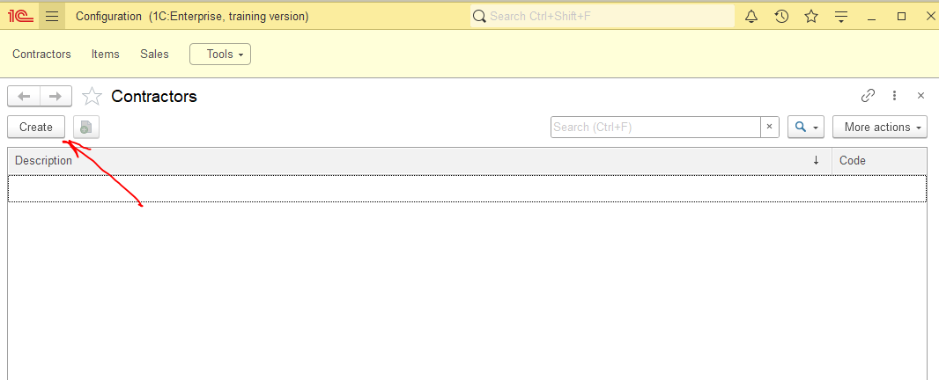
CATALOGS ENTERPRISE MODE

Slide 27
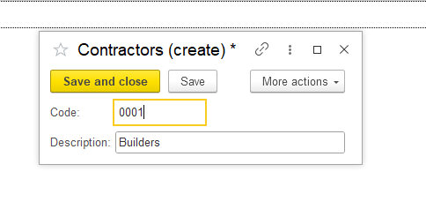
CATALOGS ENTERPRISE MODE

Slide 28
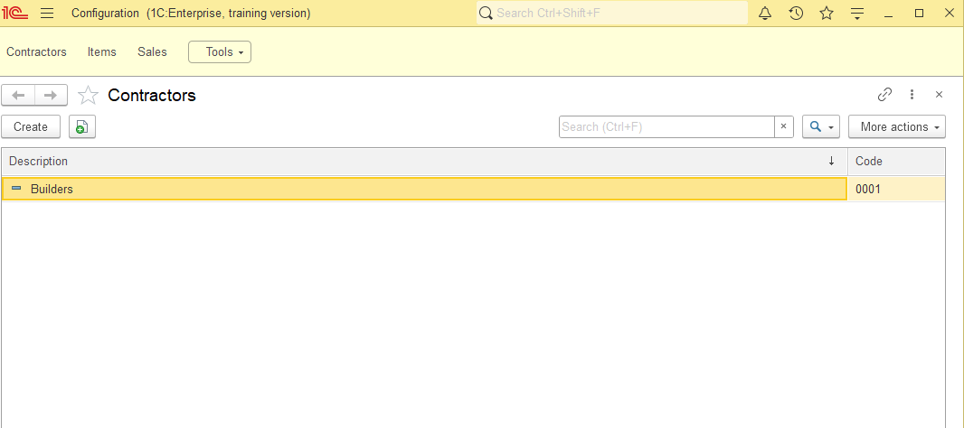
CATALOGS ENTERPRISE MODE

Slide 29
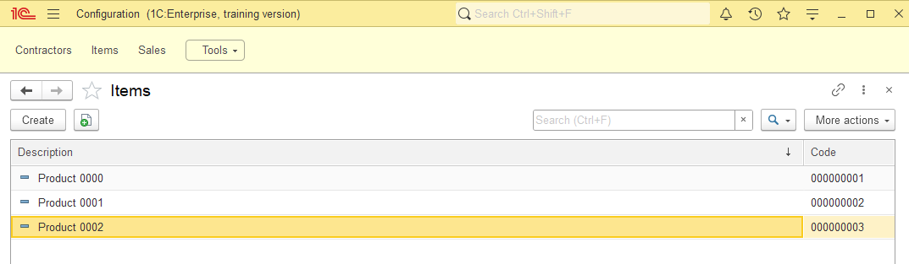
CATALOGS ENTERPRISE MODE

Slide 30
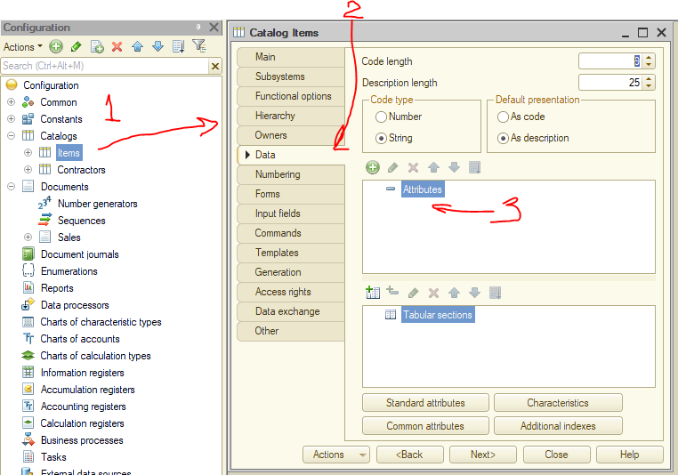
CATALOG ATTRIBUTES DESIGNER MODE

Slide 31
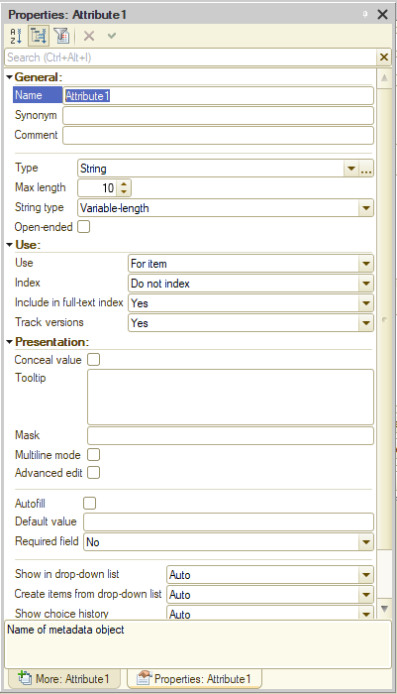
CATALOG ATTRIBUTES DESIGNER MODE
RULES:
DON'T USE SPECIAL SYMBOLS
DON'T START WITH A NUMBER
USE CAPITAL LETTERS(CAMEL CASE)

Slide 32
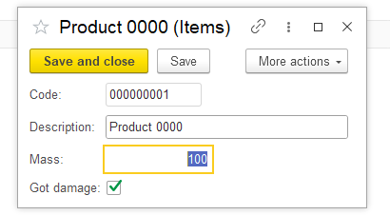
CATALOG ATTRIBUTES ENTERPRISE MODE

Slide 33
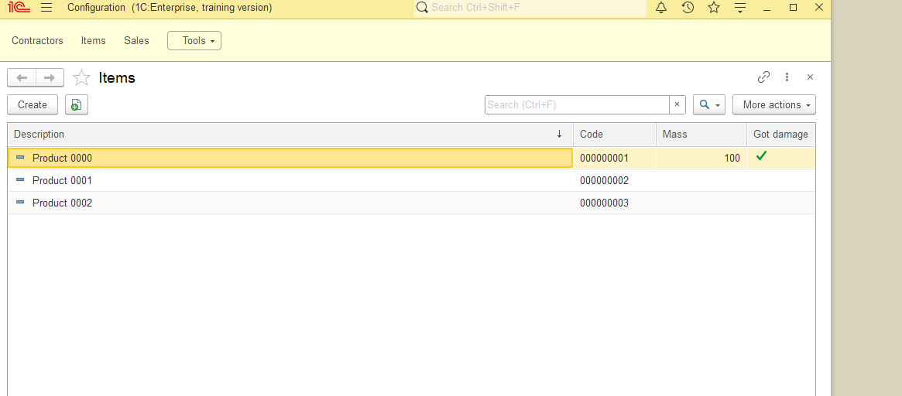
CATALOG ATTRIBUTES ENTERPRISE MODE

Slide 34
CATALOG ATTRIBUTES ENTERPRISE MODE

Slide 35
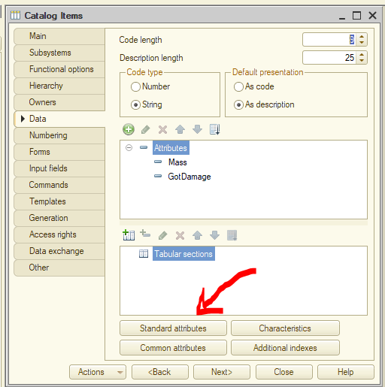
STANDARD ATTRIBUTES DESIGNER MODE

Slide 36
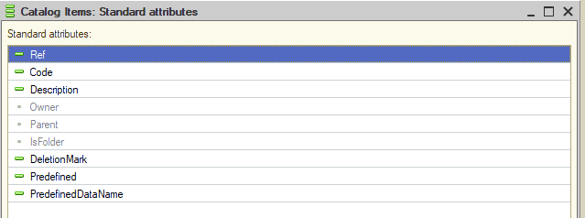
STANDARD ATTRIBUTES DESIGNER MODE
We CAN use standard attributes BUT we CANNOT change there name or type

Slide 37
STANDARD ATTRIBUTES DESIGNER MODE
Ref - is a data type corresponding to a specific metadata object, but when we work with an object we can read, write and edit. Ref only gives us to read the data and use it somewhere else.

Slide 38
STANDARD ATTRIBUTES DESIGNER MODE
Code is a unique value for any element system is using. Can change code manually but not the name or type.

Slide 39

STANDARD ATTRIBUTES DESIGNER MODE
Description is an exact name of an attribute.
is a marker for subordination mechanism (to filter information)
is a name of a folder where the element is stored
is a boolean marker to show if this element is a folder

Slide 40

STANDARD ATTRIBUTES DESIGNER MODE
Description is an exact name of an attribute.
- to show if user decided to delete an element (mark for admin)
- to show if marker got any predefined value
- name of an exact element or field in which data is predefined

Slide 41
NEXT WEEK PREVIEW WHAT’S COMING
MORE 1C LABS

